Slide 1
2022 State of the County Health Report
Robeson County Health department

Slide 2
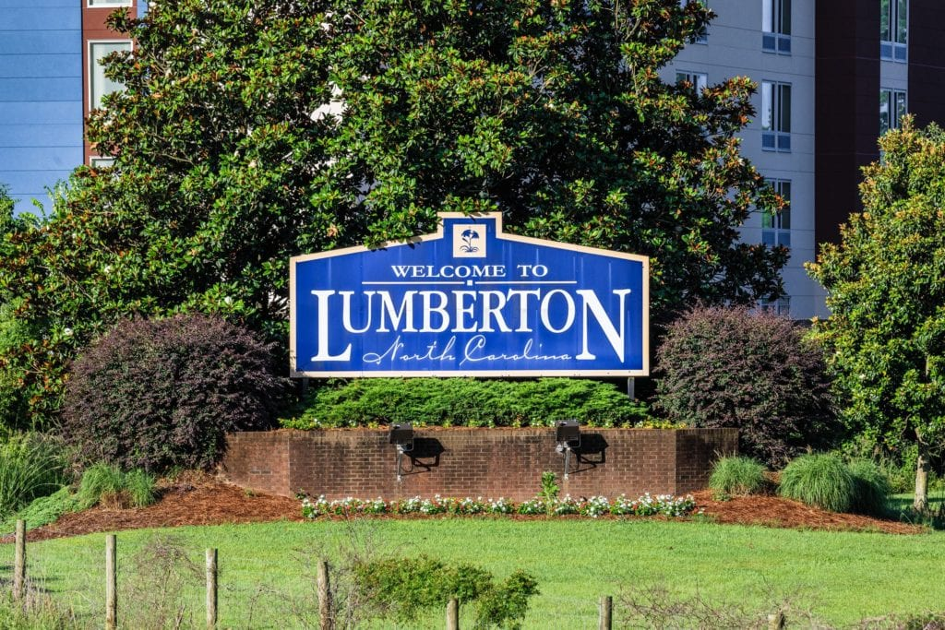
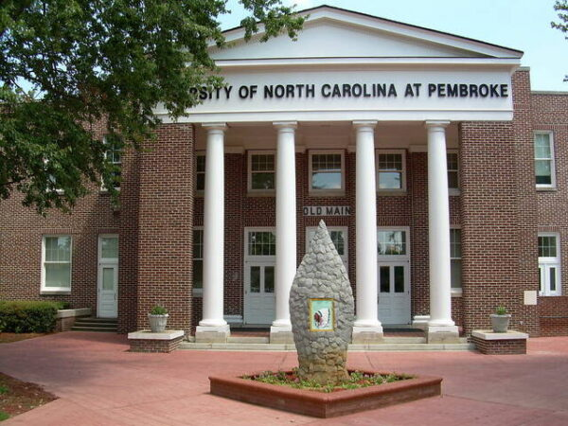
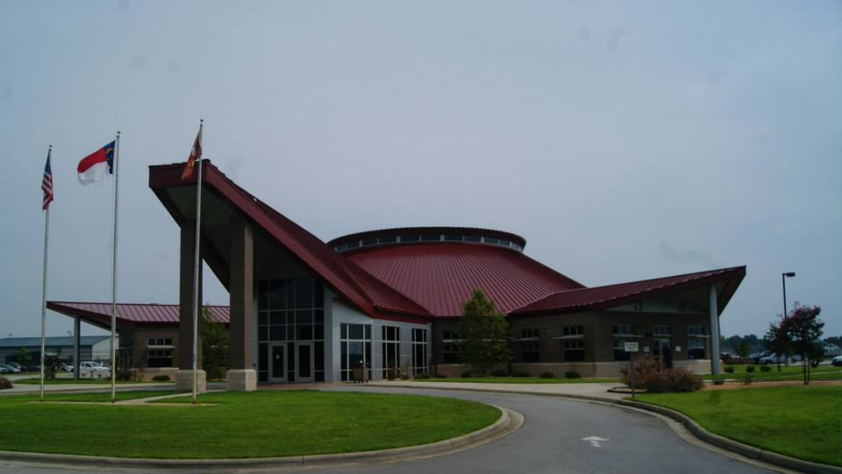
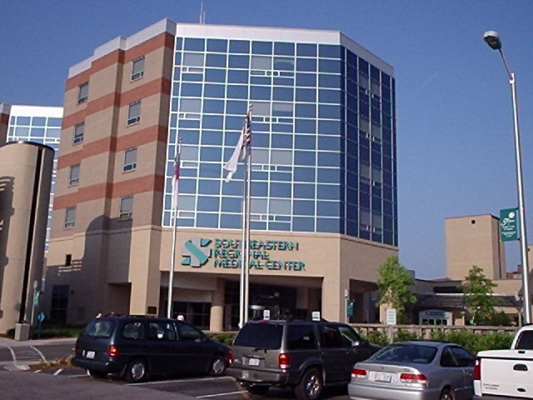
Robeson County North Carolina
Notes:
Public Images

Slide 3
Purpose
This document provides a review of the priority health issues determined during the 2020 Community Health Assessment compiled and published by Healthy Robeson. Healthy Robeson, Robeson County Health Department and other community partners have worked to address several community concerns.

Slide 4
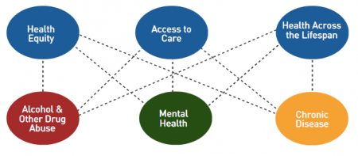
Priorities
Community Health Priorities
In Robeson County, the most recent Community Health
Assessment (CHA) was conducted in 2020. The CHA
process included a review of community health indicators,
community opinion survey, a community priority setting
activity and action planning on leading priorities. The community
Health Needs Assessment identified two priority areas; obesity and
Substance misuse/mental health. These priority areas were selected from our CHNA.

Slide 5
Demographics At a Glance (source: US Census)
PEOPLE
Population
Population Estimates, July 1 2022, (V2022) | 116,328
Population, Census, April 1, 2020 | 116,530
Population, Census, April 1, 2010 | 134,168
Age and Sex
Persons under 5 years, percent | 6.6%
Persons under 18 years, percent | 25.2%
Persons 65 years and over, percent | 16.0%
Female persons, percent | 51.9%
Race and Hispanic Origin
White alone, percent | 29.3%
Black or African American alone, percent(a) | 23.2%
American Indian and Alaska Native alone, percent(a) | 43.6%
Asian alone, percent(a) | 0.6%
Native Hawaiian and Other Pacific Islander alone, percent(a) | 0.2%
Two or More Races, percent | 3.0%
Hispanic or Latino, percent(b) | 9.3%
White alone, not Hispanic or Latino, percent | 23.3%

Slide 6
Morbidity and Mortality
Rank | Cause | Number | %
1 | Diseases of heart | 355 | 24.0
2 | Cancer | 283 | 19.1
3 | All other unintentional injuries | 90 | 6.1
4 | Cerebrovascular diseases | 81 | 5.5
5 | Alzheimer's disease | 70 | 4.7
6 | Chronic lower respiratory diseases | 62 | 4.2
7 | Diabetes mellitus | 54 | 3.6
8 | Motor vehicle injuries | 50 | 3.4
9 | Nephritis, nephrotic syndrome and nephrosis | 42 | 2.8
10 | Influenza and pneumonia | 34 | 2.3
 | All other causes (Residual) | 361 | 24.3
Total Deaths -- All Causes |  | 1482 | 100.0
Notes:
Source: State Center for Health Statistics, North Carolina

Slide 7
County Health Rankings
County Health Rankings The County Health Rankings report measures the health of nearly every county in the nation. Published online at www.countyhealthrankings.org The rankings help counties understand what influences how healthy residents are and how long they will live. Counties receive two rankings; health outcomes and health factors. Health outcomes rankings are based on an equal weighting of mortality and morbidity measures. Health Factors rankings are based on weighted scores of four types of factors; behavioral, clinical, social and economic and environmental
Year | Health Factor Ranking | Health Outcome Ranking
2019 | 100 | 100
2020 | 100 | 100
2021 | 100 | 100
2022 | 100 | 100

Slide 8
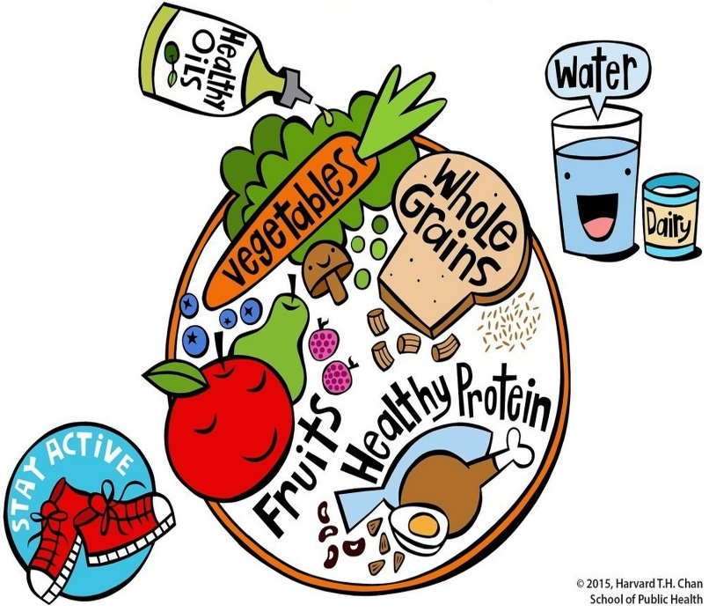
2022 Robeson State of the County Health Report
Obesity Priority One
CATCH; after school program that focuses on nutrition education and the importance of physical activity. In 2022; 17 sites (7064 students) participated in CATCH. CATCH Early Childhood enrolled - 13 sites (845 children) andCATCH Kid's Club After School - 16 sites (611 children).
Color Me Healthy program teaches 4 and 5 year old’s about healthy eating and exercise. Color Me Healthy Robeson is an evidenced informed nine lesson program that uses color, music, dance and imaginary play to provide opportunities for physical activity and to teach children about fruits and vegetables. Color me Healthy served 195 four and five year old's in daycares throughout Robeson County.

Slide 9
Substance Misuse/Mental Health Priority Two
Robeson Health Care Corporation along with Robeson County Health Department held three medicine take back events in 2022. These events were held in St. Paul's at the Robeson Health Care Clinic. Lumberton at the State Employees Credit Union. The last one was held in Red Springs at Robeson Health Care Corporation.
Family Drug Treatment Court; Increases family reunification and positive family relationships, addresses recovery for substance involved parents, helps families overcome trauma-related difficulties, creates an environment that will allow children to experience a high quality atmosphere while helping develop their cognitive, social and behavioral abilities. Twenty-one participants completed Family Drug Treatment Court in 2022.
Naloxone quickly reverses an overdose by blocking the effects of opioids. Robeson County’s local sheriffs office provides Narcan training to the patrol division. Patrol division once trained is be able to administer Narcan in the event of a potential overdose in the field.

Slide 10
New, Paused & Emerging Public Health Issues
Even though Robeson County is a small, rural county, it has not been exempt from vaping related incidents among youth. Electronic cigarettes (e-cigarettes) are battery-powered devices that contain an aerosol that is inhaled. The aerosol usually contains nicotine, artificial flavorings or other chemicals, and they resemble cigarettes, cigars, pipes, pens or long USB flash drives. Vaping is the act of inhaling a vaporized liquid that is produced by an electronic device such as an e-cigarette.
The latest data show that more than 1 in 4 high school students are using e-cigarettes (compared to approximately 1 in 10 just two years ago). More than 5 million high school students are now using e-cigarettes. illness have been reported among e-cigarette users in virtually every state, resulting in several deaths.
The Stanford Reach Lab is excited to launch their new vaping prevention curriculum, You and Me, Together Vape-Free. Participating schools could receive $2,000 over the course of 3 years while educators who are teaching the curriculum $200 over the course of 2 years and students taking the surveys: $10 gift card for each survey.
The LEAD program works to divert people suffering with substance use disorders to rehab programs instead of jail cells continues through a partnership between the Robeson County Sheriff’s Office and District Attorney’s Office. LEAD allows law enforcement officers to redirect low-level offenders to community-based programs and services. Offenders in this program are evaluated and receive treatment for substance use disorders followed by placement into rehabilitative housing and job placement or training.
The purchase of six mobile health unit buses was made possible by $2.5 million in federal Substance Abuse and Mental Health Services Administration funding. The units will be staffed with personnel from the following providers: ATS of North Carolina, Stephens Outreach Center, Waynesboro Family Clinic, and Holt Assessment Services. The hope is that the health units are a “big part of the solution” when it comes to addressing and treating substance use disorders.
Presently Too Good for Drugs has been paused. Too Good for Drugs an evidence based prevention program that helps to prevent use of opioids and other substances in multiple populations.

Slide 11
New, Paused & Emerging Public Health Issues
Outbreaks can happen in areas where people may be unvaccinated or under-vaccinated, including the United States. Right now, measles outbreaks are occurring in every region of the world. Measles can enter the United States through infected travelers entering or travelling through to the U.S. as well as through infected U.S. travelers returning from other countries.
Over 61 million doses of measles-containing vaccine were postponed or missed due to COVID-19 related delays in supplementary immunization activities. This increases the risk of bigger outbreaks around the world, including the United States.
The community level of Covid-19 in Robeson County is low based on cases and hospitalizations, according to the most recent update from the C.D.C. on Feb. 23.
The numbers of hospitalized Covid patients and deaths in the Robeson County area have remained at about the same level.
The test positivity rate in Robeson County is high.
An average of 21 cases per day were reported in Robeson County, about the same as the average two weeks ago. Since the beginning of the pandemic, a total of 52,008 cases have been reported.
Since the beginning of the pandemic, at least 1 in 216 residents have died of Covid-19, a total of 605 reported deaths.

Slide 12
New, Paused & Emerging Public Health Issues
During the first post pandemic meeting of the Robeson County Committee of 100, Robeson County Economic Development Director Channing Jones pointed to a list of more than a dozen projects promising about 1,000 new jobs in greater Robeson County.
This Photo by Unknown Author is licensed under CC BY-SA-NC
This Photo by Unknown Author is licensed under CC BY-SA

Slide 13
New, Paused & Emerging Public Health Issues
Robeson County Career and Technology Education Center
Ground was broken Thursday for the historic Robeson County Career and Technology Education Center and Planetarium that will provide innovative technologies and programs for students in the Public Schools of Robeson County.
Robeson County Economic Development Director Channing Jones said the center will have a positive and direct economic impact on Robeson County residents.
“Our nation’s primary driver for economic development is developing a skilled workforce. Establishing a technology high school in Robeson County is critically important to prepare our next generation of highly trained individuals,” Jones said.
Source: The Robesonian
Notes:
https://www.robesonian.com/news/238596/psrc-turns-dirt-for-career-and-technology-education-center

Slide 14
New, Paused & Emerging Public Health Issues
Business is booming in Robeson County. In June, the first tenant of the area’s upcoming industrial park, Elkay Manufacturing, was announced. Now, more progress in the park is underway.
The 215-acre park will be in between Interstate 74, Business 74 and Interstate 95 in Robeson County.
“It is unique. The park is being marketed as an industrial park so it will house industrial, distribution type applicants,” Jones said.
Jones did not have any additional tenant names to disclose but said they were in negotiations with different companies.
Jones further stated, “I think this is going to be one of the premier industrial parks on the eastern seaboard,”… the proximity of this particular park to the Port of Wilmington, to our airports, a lot of our sister counties and Robeson county will benefit from this.”
Source: The Robesonian

