Slide 1

2019 State of the county health report
Robeson County Health Department

Slide 2
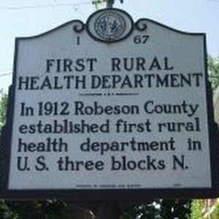
Purpose
  This document provides a review of the priority health issues determined during the 2017 Community Health Assessment compiled and published by Healthy Robeson. Over the past few years, Healthy Robeson, the Robeson County Health Department and other community partners have worked to address several community concerns. This document summarizes the status of our combined efforts.

Slide 3
Morbidity and Mortality Data

Slide 4
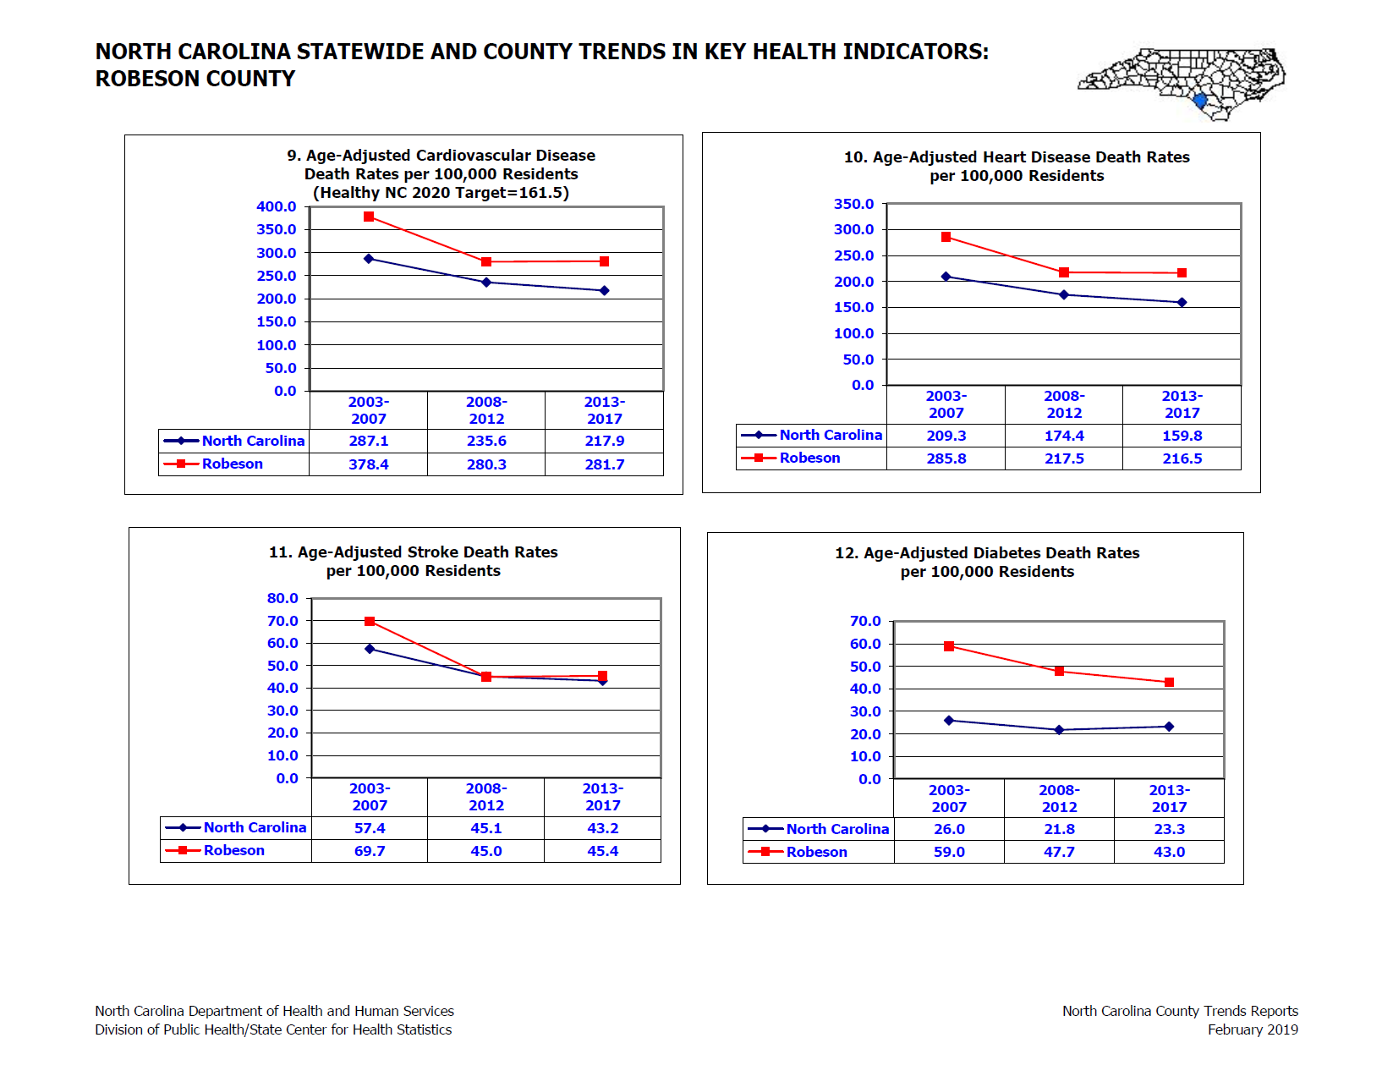

Slide 5
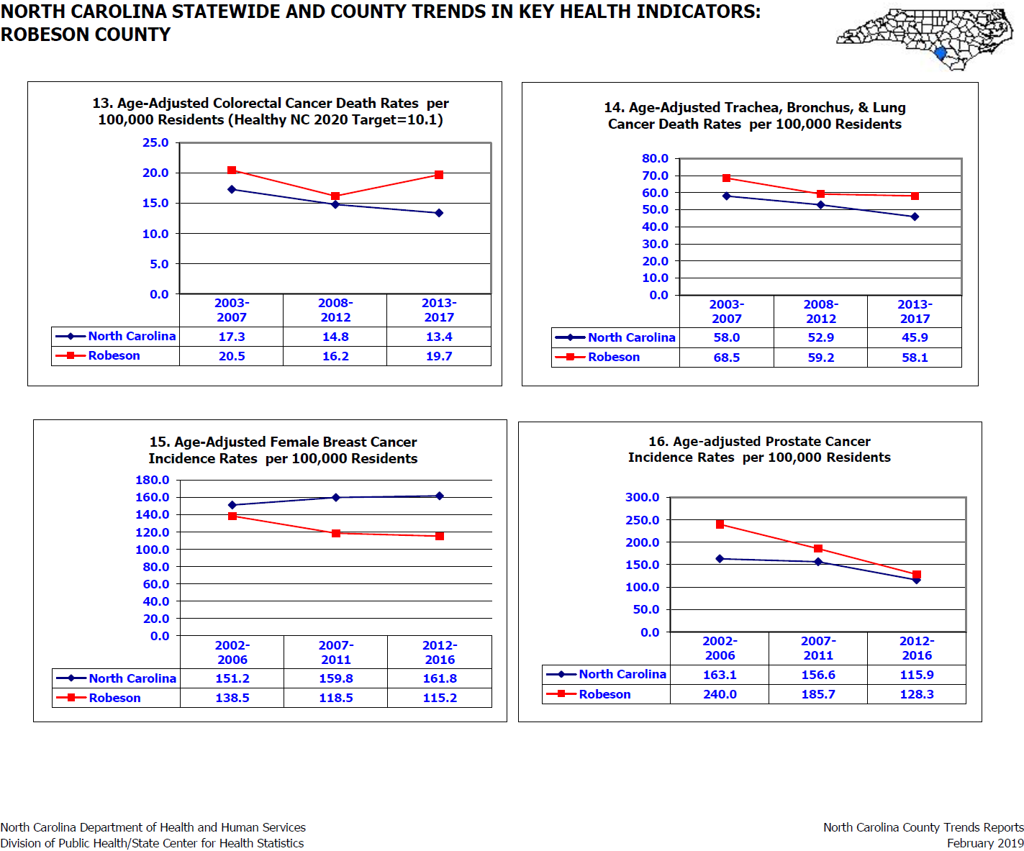

Slide 6
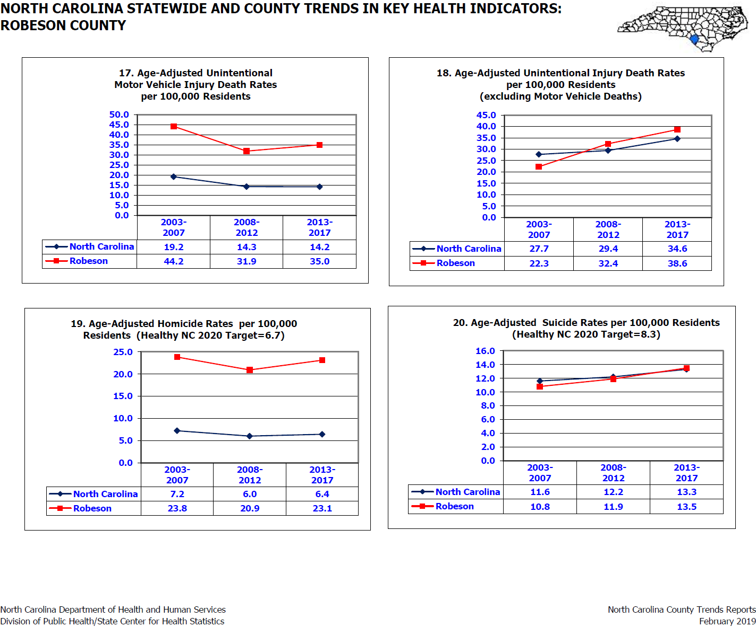

Slide 7
2018 Resident Population Estimates by Age, Gender, and Race/Ethnicity Population Estimate (131,831 residents as of
July 1, 2018 Projected from the 2020 Census

Slide 8


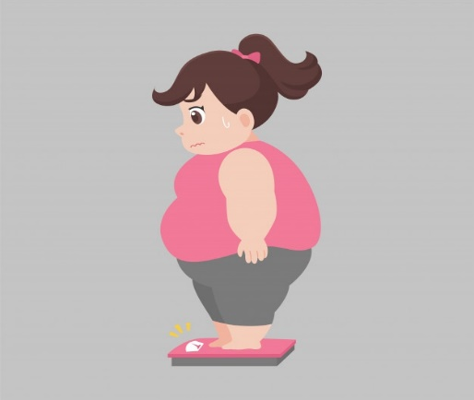
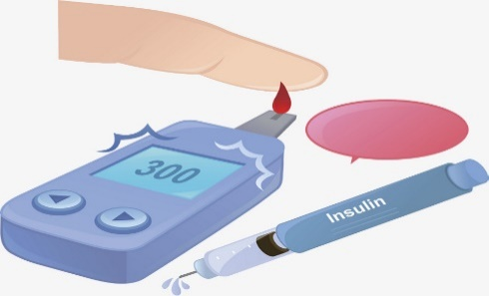


A Look at Adult Health and Wellness
27% Of Our Adults Smoke
30% Of our Adults Are Not Physically Active
38% Of Our Adults Are Obese
16% Of Our Adults Have Diabetes
216.5% Age-Adjusted Rate Of Heart Disease Deaths Per 100,000 Population
407.9% Cancer Incidence Rate Per 100,000 Population

Slide 9

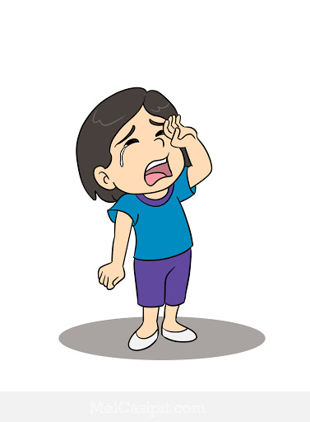


A look at Child Health & Wellness
44.4% Of our children under age 18 are living in poverty
28.7% of our children ages 0-17 are food insecure
12.2% of all babies born are low birthweight
50% of our children are living in single parent households

Slide 10
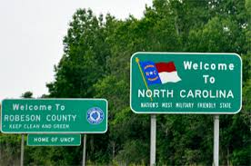
County Health Rankings
The County Health Rankings report measures the health of nearly every county in the nation. Published online at www.countyhealthrankings.org, the rankings help counties understand what influences how healthy residents are and how long they will live. Counties receive two rankings: Health Outcomes & Health Factors. Health Outcomes rankings are based on an equal weighting of mortality and morbidity measures. Health Factors rankings are based on weighted scores of four types of factors: behavioral, clinical, social and economic, and environmental.
Year | Health Factor Ranking | Health Outcome Ranking
2017 | 100 | 100
2018 | 100 | 100
2019 | 100 | 100

Slide 11
Community Health Priorities and Action Steps
Results from the 2017 CHNA, Robeson agreed to work on the following three priority areas for the next three years: (1) Obesity, (2) Substance Misuse/Mental Health (3) Social Determinates of Health. Updates towards our three priorities/action plans is highlighted on the following pages.
Focus: Chronic Disease Management and Prevention
Priority 2: Substance Misuse/Mental Health
Priority 3: Social Determinates of Health
Priority 1: Obesity
Nutrition
Physical Activity
Tobacco
Prescription Drugs
Education
Alcohol

Slide 12
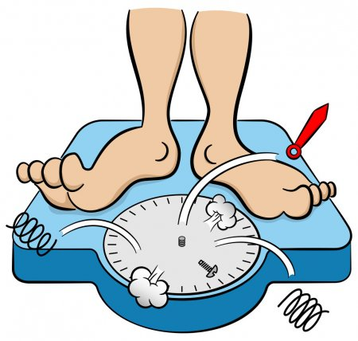
Priority #1: Obesity
Our obesity prevention action plan includes the following interventions; Chronic Disease Self-Management, Faithful Families, CATCH(Coordinated Approach to Child Health), and the 5,4,3,2,1, Go! Curriculum.
CATCH is an after-school program that focuses on nutrition education and the importance of physical activity. Seven Schools, with a total of 2,290 students have participated in this evidence based intervention from September 2017 – August 2019. Our desired outcome as stated in our 2017-2020 Community Health Action Plan was 7 schools; thus we have met our anticipated outcome. By December 2020, will have exceeded our desired outcome.
5,4,3,2,1 Go! Consists of a quick lesson on nutrition and ends with a fun activity that includes learning all about healthy, active lifestyles. During the 2018-2019 academic year, 3 schools and a total of 800 students participated in this evidence based intervention. The previous academic year, 7 schools and 2,128 students participated. Our desired outcome, as stated in our 2017-2020 community health action plan was 9 schools. With 10 schools have completed the program, we have already surpassed our desired outcome of 9 schools.
Faithful Families was implemented in January, 2019 at Saint Matthews AME Zion Church. Due to poor attendance all of the required sessions were not completed. According to our action plans, our desired outcome is to have 4 workshops by December 2020.
Chronic Disease Self-Management - held 1class (February, 5 - March, 11 2019); and in 2018 1 class was completed. Our desired outcome, according to our 2017-2020 action plan, is 4 classes.

Slide 13
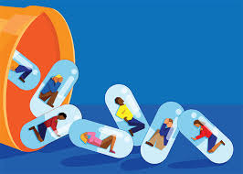
Priority #2: Substance Misuse/Mental Health
Addiction to drugs and or alcohol affects millions nationwide. Addiction is chronic, it is progressive, and if left untreated, it can be fatal.
Interventions from our action plans include; Family Drug Treatment Court, and medication take back events. Family Drug Treatment Court is to increase family reunification and positive family relationships. Address recovery for substance-involved parents. Help families overcome trauma-related difficulties. Create an environment that will allow children to experience a high quality atmosphere while helping develop their cognitive, social, and behavioral abilities. A total of 114 parents and children were served by FDTC in the year 2019. Of the 114, 41 were parents and 73 were children. Our expected outcome stated in our 2017-2020 action plan is to serve 500 persons through Family Drug Treatment Court by May 21, 2020.
Our 2017-2020 action plan states a goal of 4 take back events will occur. Two events have occurred since the action plan was written. Because of hurricane activity in our county since the action plan was written, we no longer conduct Operation Medicine Drop twice annually. We now only conduct a spring event. We should be on target with our stated outcome by the conclusion of 2020.
Since 2011, a total of 1,826, 640 pills have been collected through “Operation Medicine Drop” events and the 6 permanently placed drop boxes located in pharmacies and police department within the county.

Slide 14
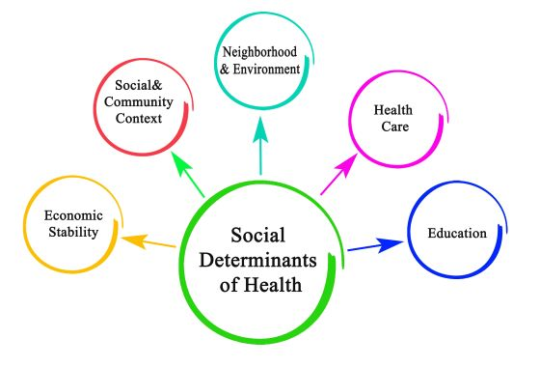
Priority #3 Social Determinants of Health
Why Try is an evidence-based resiliency program designed to improve student’s social emotional learning. In 2019, a total of 239 youth within PSRC participated in Why Try which teaches students social and emotional principals in a way that they can understand. In 2018, 575 students participated in the program. Our expected outcome, as stated in the 2017-2020 action plan was 460 students; we have already exceeded our expected outcome.
Jobs for America’s Graduates (JAG) is a state-based national non-profit organization dedicated to preventing dropouts among young people who have serious barriers to graduation and/or employment. To date, 48 students have participated in JAG. Our expected outcome, according to our 2017-2020 action plan is 400 students.
The Health Department along with Robeson Community College provides health education for students through a Single Stop Health Information Center. All students can discuss issues of concern in a confidential manner with representatives of our Health Education Department.
A total of 233 students participated in Single Stop during 2019. According to our action plan for 2017-2020, our expected number of agencies participating in Single Stop is 25. In 2019, there were 7 agencies participating. In order to meet our expected outcome, we must encourage additional agencies to participate.

Slide 15
New & Emerging Issues
From January through December 2019 there were 371 overdoses and Narcan was given 303 times.
Since 2016, funding to address diabetes prevention in minority communities has been awarded by the NC Office of Minority Health and Health Disparities. To date, 1,327 individuals from 3 counties (Robeson, Bladen Columbus) have been screened and provided nutrition education. A total of 21 classes have been conducted; and 289 participants have completed all 26 training modules. This grant will conclude as of May 31, 2020; and efforts are underway to secure a new funding source(s).
From January-October 2019, 17 business have initiated breastfeeding policies and have become breastfeeding friendly. This includes, Elkay; Smithfield, and Graphic Packaging.
Awarded $45,500 by the NC Public Health Preparedness and Response (PHP&R) Branch; and funds will be used for a TB awareness campaign. Robeson ranks first in NC in TB rates (12.8 per 100,00; other counties are < 5 per 100,000.)
Another new grant is the Sustained Access to Healthcare Services Project Hurricane Relief/Capital Project Grant SFY 2020. The NC Office of Rural Health was awarded one-time funding in the amount of $1,000,000 from the Kate B. Reynolds Charitable Trust. The NC ORH issued a request for proposals to the 34 FEMA-identified counties affected by Hurricane Florence. Robeson is one of 9 health departments in the state to receive funding through this initiative.

Slide 16
Continued New & Emerging Issues
Innovative Approaches (IA)- Focuses on systems changes for children and youth with special health care needs (CYSHCN) residing in Robeson, Bladen, and Columbus Counties.
Robeson County is now in the third wave of funding; we mush show sustainability as of May 31, 2020
Bladen and Columbus funded through May 31, 2022.
New KBR funding for Adverse Childhood Experiences (ACES) and Resiliency has been awarded. Prevent Child Abuse NC took the lead role in applying.
KBR grant does include a regional initiative consisting of Robeson, Bladen and Columbus counties.

